Slide 1
CSS Topics

Slide 2
Border
border-style
border-color
border-width
border-radius

Slide 3
CSS border-style
The Border style property is used to specify the border type which you want to display
none | It doesn't define any border.
dotted | It is used to define a dotted border.
dashed | It is used to define a dashed border.
solid | It is used to define a solid border.
double | It defines two borders wIth the same border-width value.
groove | It defines a 3d grooved border. effect is generated according to border-color value.
ridge | It defines a 3d ridged border. effect is generated according to border-color value.
inset | It defines a 3d inset border. effect is generated according to border-color value.
outset | It defines a 3d outset border. effect is generated according to border-color value.

Slide 4
CSS border-width
border-width: medium;
border-width: 5px;
border-width: Thin;
border-width: Thick;

Slide 5
border-radius
The border-radius property is used to add rounded borders to an element:
border-radius: 10px;

Slide 6
Example
<html>
<body>
<h1 style="border-style:dotted; border-color:red;" > hello</h1>
<h1 style="border-style:solid; border-width:20px;border-radius:30px;" > hello</h1>
<h1 style="border-style:groove; border-width:thick;" > hello</h1>
</body>
</html>

Slide 7
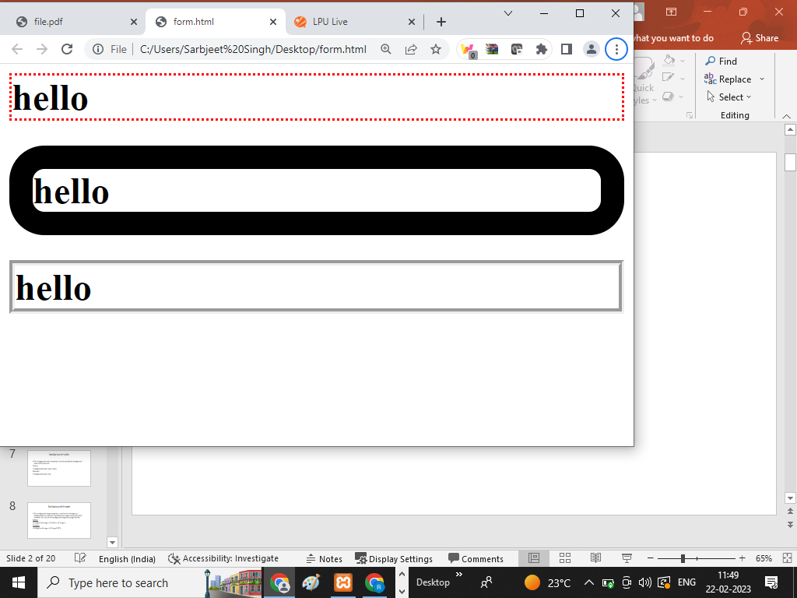
OUTPUT

Slide 8
Background
CSS background property is used to define the background effects on element. There are 5 CSS background properties that affects the HTML elements:
background-color
background-image
background-repeat
background-attachment
background-position

Slide 9
background-color
The background-color property is used to specify the background color of the element.
Syntax:
background-color: color name;
Example:
background-color: red;

Slide 10
background-image
The background-image property is used to set an image as a background of an element. By default the image covers the entire element. You can set the background image for a page like this.
Syntax:
background-image: url(‘address of image’);
Example:
background-image: url('image1.jfif’);

Slide 11
background-repeat
By default, the background-image property repeats an image both
horizontally and vertically.
Some images should be repeated only horizontally or vertically
background-repeat: repeat-x;
background-repeat: repeat-y;
background-repeat: no-repeat;

Slide 12
background-attachment
The background-attachment property is used to specify if the background image is fixed or scroll with the rest of the page in browser window. If you set fixed the background image then the image will not move during scrolling in the browser.
background-attachment: fixed;
background-attachment: scroll;

Slide 13
background-position
The background-position property is used to define the initial position of the background image. By default, the background image is placed on the top-left of the webpage.
You can set the following positions:
center
top
bottom
left
right
background-position: right bottom;

Slide 14
shorthand property background:
To shorten the code, it is also possible to specify all the background properties in one single property
When using the shorthand property the order of the property values is:
background-color
background-image
background-repeat
background-attachment
background-position
background: #ff1222 url("img.png") no-repeat right top;

Slide 15
Example
<html>
<body style="background-image: url('image1.jfif’);
background-repeat:no-repeat;
background-position: right bottom;" >
<h1>Hello </h1>
<p style=" background-color: red;"> background color</p>
</body>
</html>

Slide 16
Color
The color property in CSS is used to set the color of HTML elements. This property is used to set the background color or the font color of an element.
Syntax: color: specify color here;
Formats of colors:
RGB format.
RGBA format.
Hexadecimal notation.
HSL.
HSLA.
Built-in color.

Slide 17
RGB format
'RED GREEN and BLUE’
rgb() property.
property allows three values that can either be in percentage or integer (range from 0 to 255).
Syntax: color: rgb(R, G, B);
Example: color: rgb(10,20,32);

Slide 18
RGBA format
RGBA contains A (Alpha) that specifies the element's transparency
alpha is in the range 0.0 to 1.0
0.0 is for fully transparent
1.0 is for not transparent

Slide 19
Hexadecimal notation
six-digit color representation
notation starts with the # symbol
ranges from 0 to F
first two digits represent the red (RR) color value
next two digits represent the green (GG) color value
the last two digits represent the blue (BB)
black color notation #000000
white color notation #FFFFFF

Slide 20
HSL
Full form of HSL is Hue, Saturation, and Lightness.
Hue: degree on the color wheel from 0 to 360.
0 represents red,
120 represents green,
240 represents blue.
Saturation: takes value in percentage in which
100% represents fully saturated, i.e., no shades of gray,
50% represent 50% gray, but the color is still visible, and
0% represents fully unsaturated, i.e., completely gray, and the color is invisible.
Lightness: The lightness is the light that we want to provide the color in which
0% represents black (there is no light),
50% represents neither dark nor light, and
100% represents white (full lightness).

Slide 21
HSLA
A (alpha) that specifies the element's transparency.
value of alpha is in the range 0.0 to 1.0,
0.0 indicates fully transparent
1.0 indicates not transparent.

Slide 22
Built-in Color
built-in color means the collection of previously defined colors
color : color name;

